Slide 1
Day 2 ppt : covolution
summary
Presented By-
V.Megha Saran

Slide 2
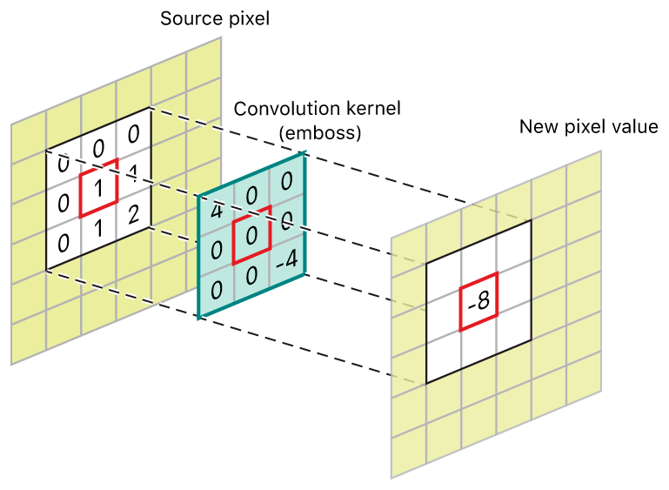
CONVOLUTION
Convolution is used to apply filters to images.
Image filtering is changing the pixel value of a specific image to blur, sharpen, emboss, or make edges more clear. It changes the appearance of the original image.
Mathematically it is an operation used to combine two functions to produce a third function.

Slide 3
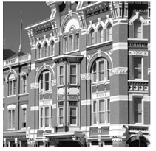
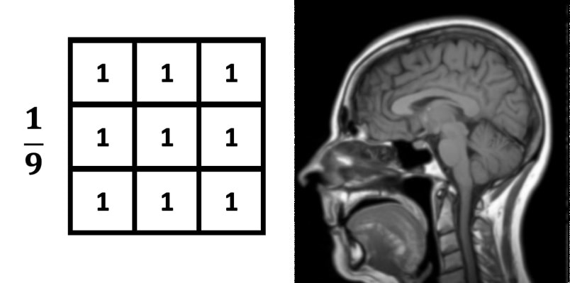
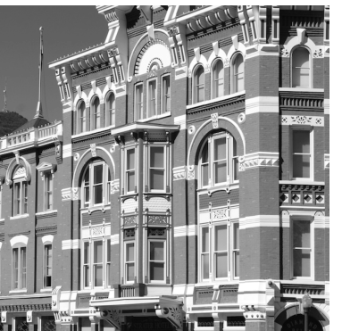
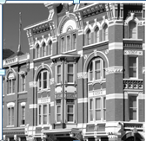
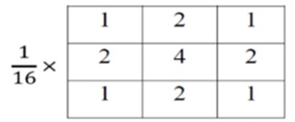
Smoothening(Blur & Gaussian Blur)

Slide 4
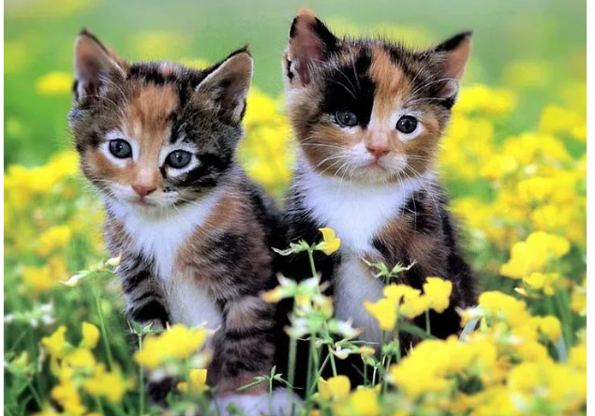
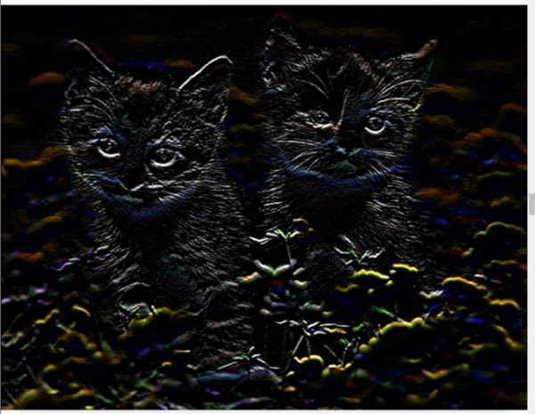
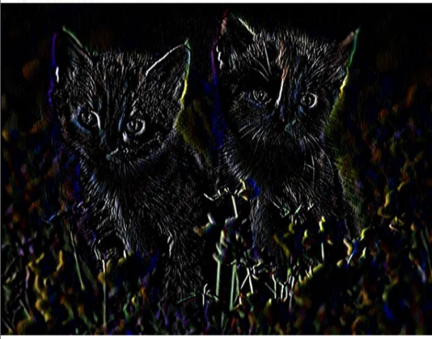
Derivative of Image
Derivative Kernel for vertical derivative
Derivative Kernel for horizontal derivative
1
-1
1 | -1

Slide 5
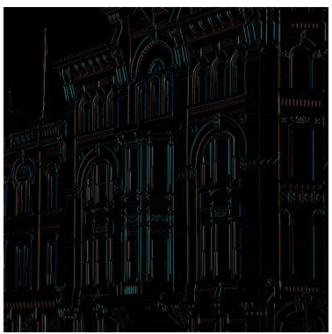
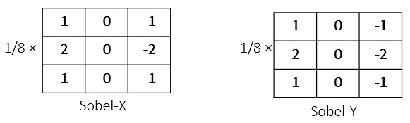
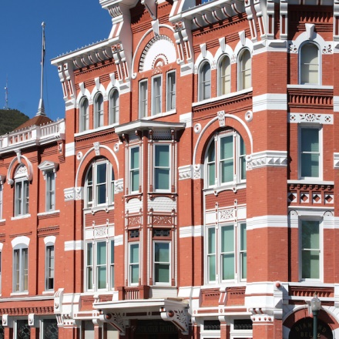
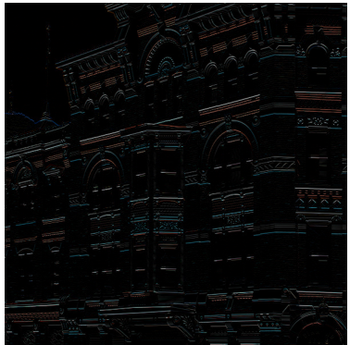
Edge Detection
Edge Detection in an image is done using Sobel filters. The image first undergoes smoothening/Gaussian Filter ,then its derivative is taken which finally gives the edges.
Sobel - Horizontal
Sobel - Vertical

Slide 6
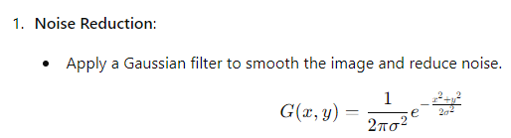
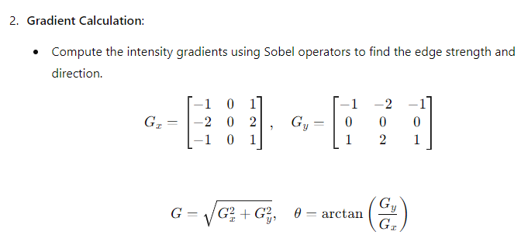
Canny Edge Detection

Slide 7
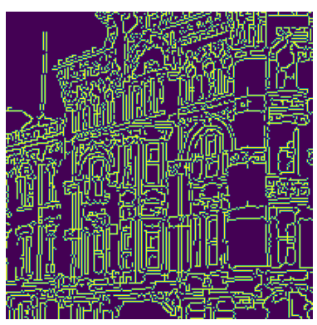

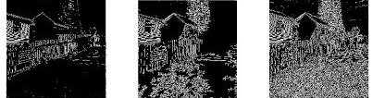
Example: Canny Edges of Image

Slide 8
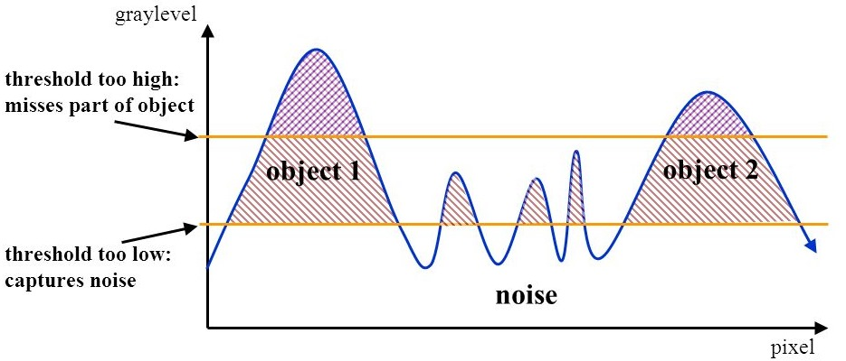
Hysteresis
Hysteresis is used to improve edge detection by connecting edges that are strong enough to form meaningful boundaries. Apply two thresholds: a high threshold to identify strong edges and a low threshold to identify weak edges. Connect weak edges to strong edges if they are in the neighborhood.

Slide 9
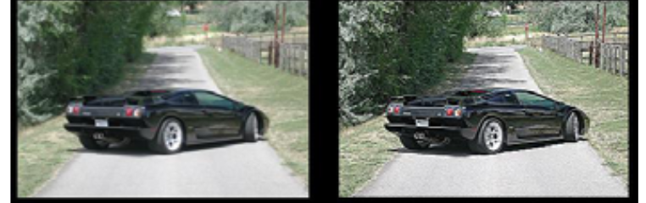
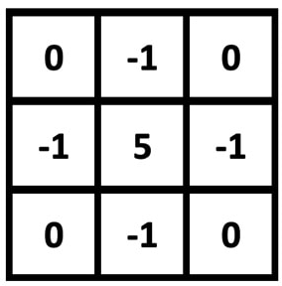
Image Sharpening
Sharpening Kernel

